Slide 1

Year 4 Multiplication Check – Parents Information Session
Monday 3rd October 2022

Slide 2
What is the MTC?
The MTC determines if Year 4 children can fluently recall their multiplication tables.
They are deigned to help schools identify which children require more support to learn their times tables.
There is no ‘pass’ rate or threshold which means that, unlike the Phonics Screening Check (taken in Year 1), children will not be expected to re-sit the check.
The Department for Education (DfE) will create a report about the overall results across all schools in England, not individual schools.
Notes:
The test is designed to identify pupils who need support, not as a diagnostic tool to assess the times tables children struggle with.

Slide 3
When does it happen?
There will be a 3 week window from Monday 5th June to Friday 23rd June 2023 for schools to administer the check.
There is no set day to administer the check and children are not expected to take the check at the same time.
All eligible Year 4 children in England will be required to take the check.
Notes:
It is up to individual schools to decide how the check is administered – some schools will administer individually while others will take small groups out or administer to the whole class.
A list of pupils who should not take the test can be found in the administration guidance of the MTC documentation.

Slide 4
How the check is carried out?
The check will be fully digital.
Answers will be entered using a keyboard, by pressing digits using a mouse or using an on-screen number pad.
Usually, the check will take less than 5 minutes for each child.
The children will have 6 seconds from the time the question appears to input their answer.
There will be a total of 25 questions with a 3 second pause in-between questions.
There will be 3 practice questions before the check begins.
Notes:
Some children will be eligible for additional support (detailed in the next slide).
6 seconds per answer means that children must be able to read, recall and enter their response within that time. Whatever is written in the answer box at the end of 6 seconds will be counted as the answer i.e. if the student intends to write 144 and only 14 is typed when the timer ends, their recorded answer is 14.
Children are allowed to practise before taking the check.
https://mathsframe.co.uk/en/resources/resource/477/Multiplication-Tables-Check example showing how quick the questions are/ types of questions.

Slide 5
Specific arrangements for the check:
Some children will be eligible for specific arrangements:
Colour contrast;
Font size adjustment;
‘Next’ button (alternative to 3-second pause);
Removing on-screen number pad;
An adult to input answers;
Audio version;
Audible time alert.
Notes:
Children eligible for access arrangements are:
Children with an EHC plan
Children who have provisions made in school using the SEND support system.
Children with behavioural, emotional or social difficulties
Children with EAL
Schools do not need to request permission to use access arrangements. The support should be based on the support provided in school and should not advantage or disadvantage individual children.
A child can be assigned more than one access arrangement, if required.

Slide 6
What sort of questions are there?
Each child will be randomly assigned a set of questions
There will only be multiplication questions in the check, not division facts.
The 6, 7, 8, 9 and 12 times tables are more likely to be asked.
Reversal of questions (e.g. 8 x 6 and 6 x 8) will not be asked in the same check.
Children will not see their individual results when they complete the check.

Slide 7
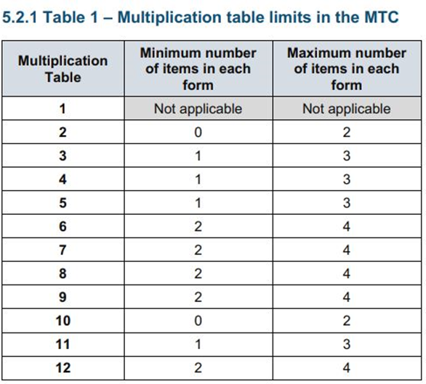
The Standards and Testing Agency (STA) state that they are classifying the multiplication tables by the first number in the question. For example, 8 x 3 would fall within the 8 times table.

Slide 8
Ways to support times table knowledge
Count and look for patterns.
Understand that multiplication is repeated addition.
Remember that multiplication is commutative.
Remember that multiplication is the inverse of division.
Recall and utilise number families.
Use different representations to represent multiplication, such as:
Concrete manipulatives suck as multilink cubes or counters.
Create pictorial representations such as arrays.
Notes:
Counting will start before beginning to develop understanding and reasoning but will continue long after, until all times tables can be counted through sequentially at speed.
Counting using manipulatives should start with physical objects (shoes, socks, hands etc) before moving on to counters etc
Whenever starting children counting in a new amount, such as counting in 8s, children should be given the opportunity to see visually what that looks like to reinforce 4 x 8 looks quite big compared to 4 x 6.
Patterns could be 4 x 8 is the same as 4 x 4 doubled.

Slide 9
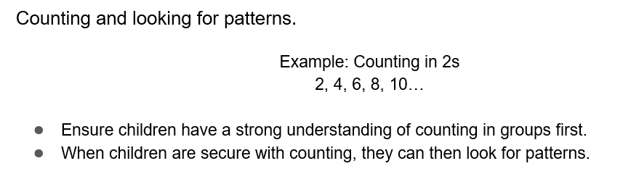


Slide 10
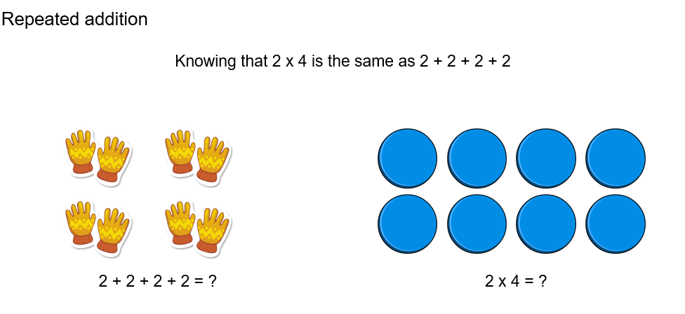
Notes:
Children need experience of using concrete manipulatives such as counters or multilink cubes and pictorial representations of objects, forming arrays.

Slide 11
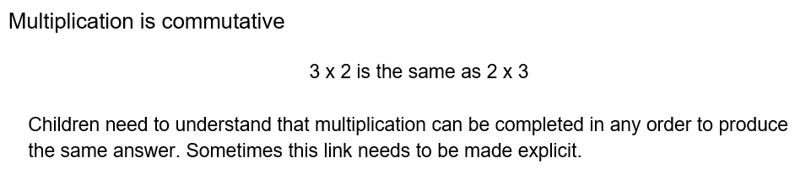
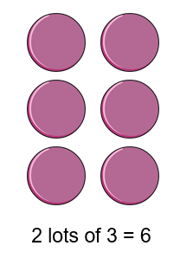
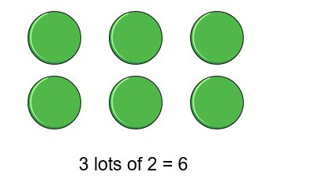
Notes:
Children build on their existing understanding using arrays, turning the arrays around to show that you now have 2 groups of 3 and they will still total 6. This can then be linked to recalling multiplication facts, e.g. if they know their 2 times table as facts but not their 3 times table, they can use 2 x 3 to work out 3 x 2.

Slide 12
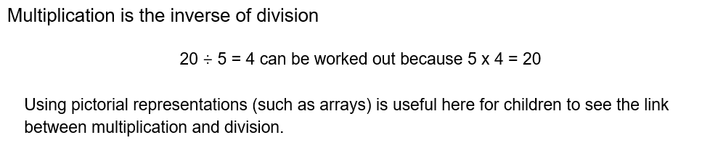
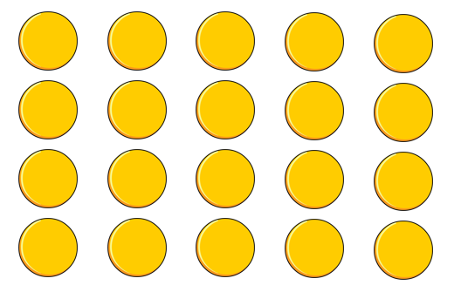
Notes:
Even though division is not tested in the MTC, it is important that pupils have a strong understanding of the connection between multiplication and division.
Again, the use of arrays is key. Children need experience of pulling arrays apart into groups or sharing. After basic experience has been gained, the children should start to ‘see’ an array structure as 5 groups of 4 equal 20 and 20 can be split into 5 groups of 4.

Slide 13
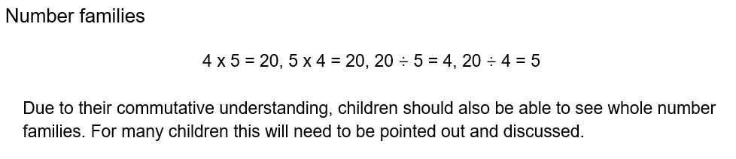
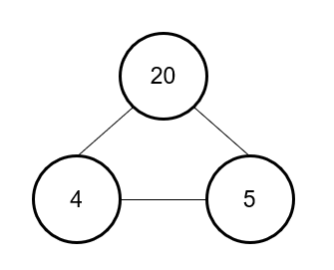
Notes:
From here it is only a short jump to understanding that any missing number can be worked out through knowledge of number families, e.g. 4 x [ ] = 20 or [ ] ÷ 4 = 5. There are other methods children can use to work out missing numbers but our goal is to increase working memory in order to increase instant recall from long term memory. Being able to bounce around a number family will achieve that.

Slide 14
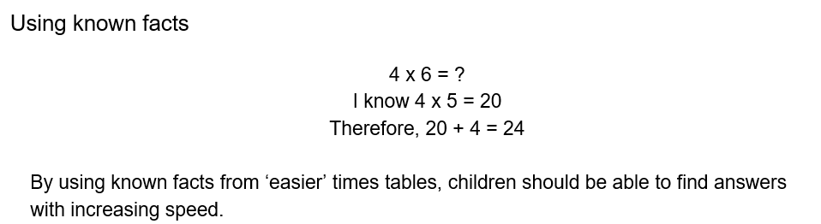
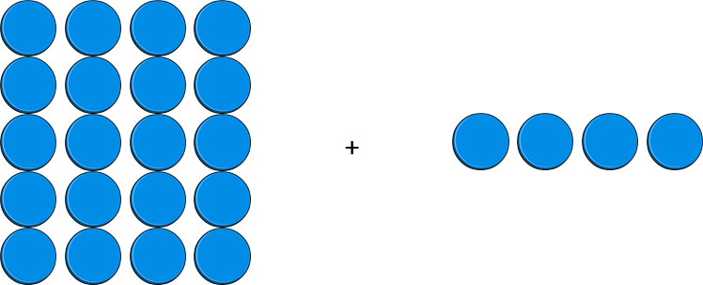

Slide 15
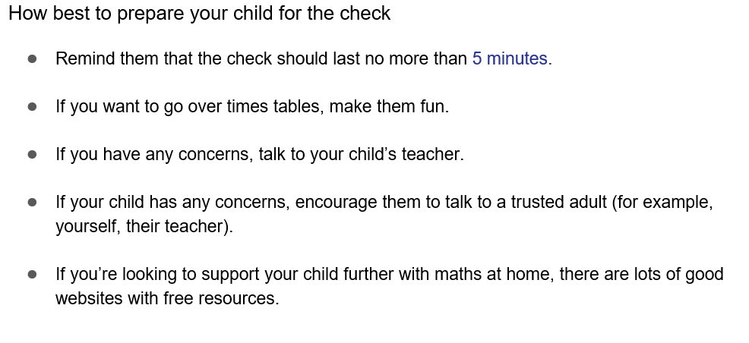
Notes:
Games to try:
Climb the stairs counting in multiples
Play time tables games verbally.
Listen and sing along to times tables songs.
Take it in turns to say times tables in funny voices.
Play maths games online.

Slide 16
Any questions?

